Slide 1
Inclusive Language
August 2021

Slide 2
Inclusive language positively reflects social and cultural diversity. It means choosing language that does not discriminate, exclude or undermine individuals and groups of people.

Slide 3
Inclusive language continuum
Totally unacceptable words
(hate crime/harassment)
Lazy, accidental language
(belittles people)

Slide 4
Communication is not what you say, it’s how you are heard.

Slide 5
Common concerns
Have you ever thought:
I’m going to get something wrong.

Slide 6
General guidelines.
Don’t say ‘suffering’ –be factual over value judgements.
Don’t refer to non-disabled people as ‘normal’.
Don’t lump together people in certain groups.
Avoid assumptions and stereotypes.
Check preferred language.
Inclusive language: words to use and avoid when writing about disability - GOV.UK (www.gov.uk)
inclusive-language-guidelines.pdf (cii.co.uk)

Slide 7
How do we manage preferred language in group settings? How do we ask an individual what their preferred terms are?

Slide 8
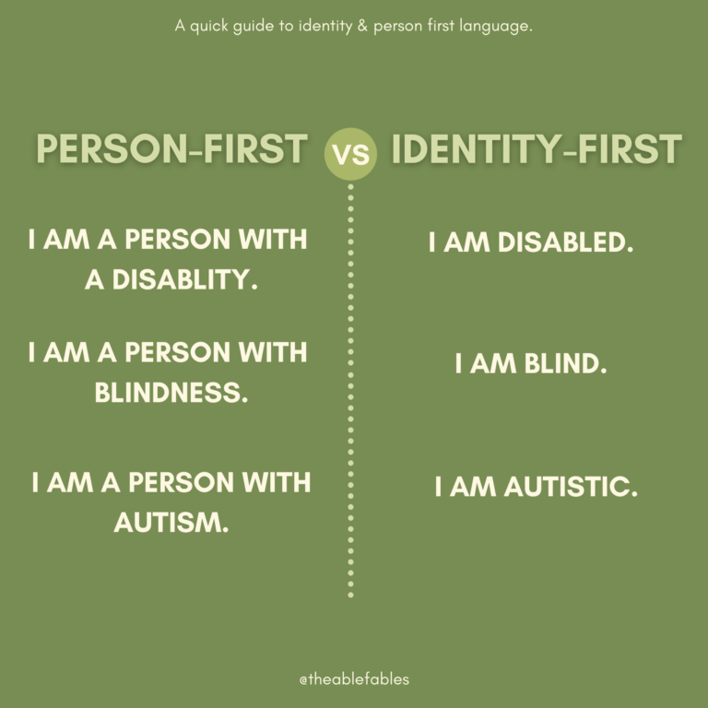
Person vs Identity- first

Slide 9
Ways to approach preferences.
If you know audience in advance, you can research guidance.
With an individual, you could say, ‘I’m mindful to use inclusive language around disabilities and neurodiversity and that there are various views on terms. Can I check your preferred terminology?’

Slide 10
Ways to approach preferences.
With a group, you could say, ' I'm going to use the term ‘disabled people’ as advised by Scope, a charity focusing on disability, as preferred term in line with social model of disability.’
Can invite people to correct you.

Slide 11
Autistic person at school in Scotland.
Has ‘additional support needs’ (ASN)
May be attending a ‘Special School’ but do not use the term ‘special needs’.
Not common to us SpLD (specific learning difference) in Scotland.
https://education.gov.scot/parentzone/additional-support/

Slide 12
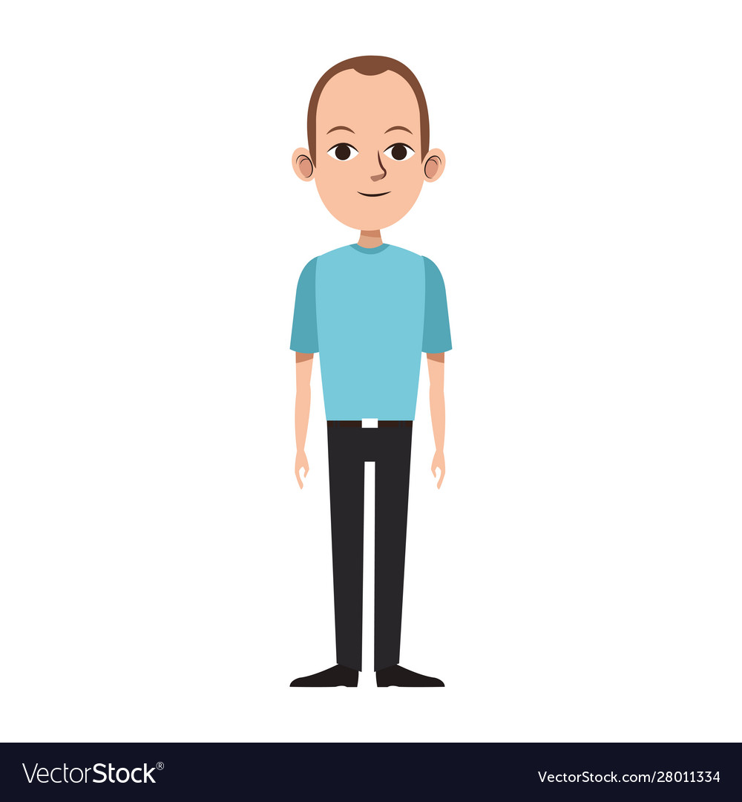
Autistic person in further or higher education.
Has ‘additional support needs’ (ASN)
Will work learning support department.
Does not need diagnosis, but it helps.
Will get a ‘personal learning support plan’

Slide 13
Autistic person in work
Not commonly referred to as having ‘additional support needs’.
Would come up as needing ‘reasonable adjustments’ under Equalities Act 2010 and having a disability. (You’re disabled under the Equality Act 2010 if you have a physical or mental impairment that has a ‘substantial’ and ‘long-term’ negative effect on your ability to do normal daily activities.)
https://www.gov.uk/definition-of-disability-under-equality-act-2010

Slide 14
Autistic person in work
Normally uses diagnostic and medical model, going through occupational health.
With CPD and events, would raise support in advance when asked if have any access or communication needs.

Slide 15
Neurodiversity
Neurodiversity: the biological reality of infinite variation in human neurocognitive functioning and behaviour, akin to ‘biodiversity’ in the natural world.

Slide 16
Neurodiversity
Neurodivergent: having cognitive functioning different from what is seen as typical.

Slide 17
Neurodiversity
Neurodiverse: this term is often used instead of ‘neurodivergent’, yet is potentially problematic (akin, perhaps, to referring to an African-Caribbean person as ‘racially diverse’). A group can be neurodiverse – an individual is likely better described as neurodivergent.

Slide 18
Neurodiversity
Neurotypical: given the biological fact that there is no such thing as a ‘normal’ brain, neurotypical is best thought of as ‘not neurodivergent

Slide 19
To sum up.
Key guidelines.
Familiarise with general principles.
Appreciate the continuum. Nature, frequency and impact.
Ask preferred terms.
Use the Inclusive Language Guide.

